Slide 1

Data Communication and Computer Network BLM3051
Dr. Öğr. Üyesi Furkan ÇAKMAK

Slide 2

Lecture Information Form - Weekly Subjects
BLM3051
Data Communication and Computer Network - 2
Hafta | Tarih | Konular
1 | 20.02.2024 | Introduction to Data Communication Standards Used on Data Communication, Architectural models
2 | 27.02.2024 | OSI Reference Model , Layers and Their Functions, Signaling and Signal Encoding
3 | 05.03.2024 | Parallel and Serial Transmission, Communication Media and Their Technical Specs., Multiplexing (TDM, FDM)
4 | 12.03.2024 | Error Detection and Error Correction Techniques, Data Link Control Techniques, Flow Control
5 | 19.03.2024 | Asynchronous and Synchronous Data Link Protocols (BSC, HDLC)
6 | 26.03.2024 | LAN Technologies Continued, IEEE 802.4, 802.5, 802.11
7 | 02.04.2024 | Connectionless and Connection Oriented Services, Switching
8 | 09.04.2024 | Tatil – Ramazan Bayramı Arifesi
9 | 16.04.2024 | 1. Ara Sınav
10 | 23.04.2024 | Tatil – 23 Nisan Ulusal Egemenlik ve Çocuk Bayramı
11 | 30.04.2024 | Static and Dynamic Routing, Congestion in the Network Layer, Its Causes and Solutions
12 | 07.05.2024 | IP (Internetworking Protocol), ICMP, BOOTP, DHCP
13 | 14.05.2024 | 2. Ara Sınav
14 | 21.05.2024 | UDP (User Datagram Protocol), TCP (Transmisson Control Protocol)
Dr. Öğr. Üyesi Furkan ÇAKMAK

Slide 3
OSI Reference Model - Reminding
BLM3051
Data Communication and Computer Network - 2
7 | Application Layer
6 | Presentation Layer
5 | Session Layer
4 | Transport Layer
3 | Network Layer
2 | Data Link Layer
1 | Physical Layer
Dr. Öğr. Üyesi Furkan ÇAKMAK

Slide 4
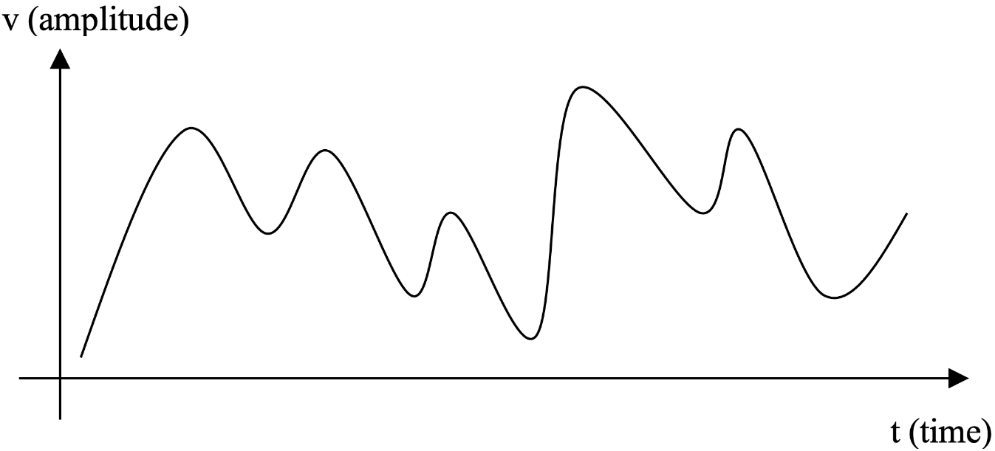
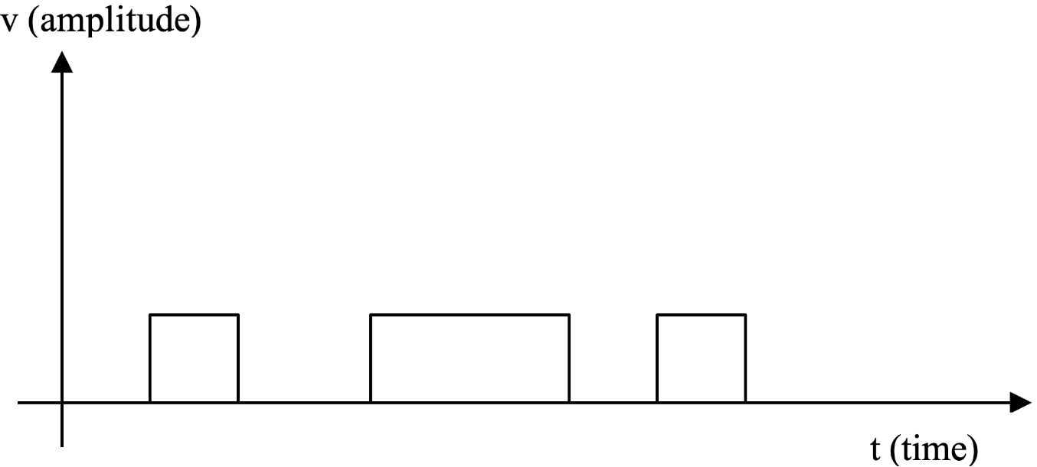
Signals
BLM3051
Data Communication and Computer Network - 2
Continious - Analog
Discrete - Digital
Dr. Öğr. Üyesi Furkan ÇAKMAK

Slide 5
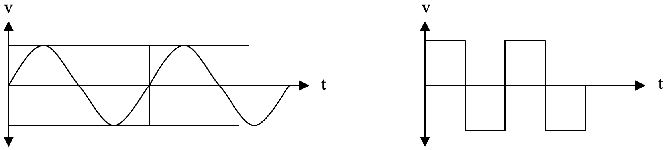
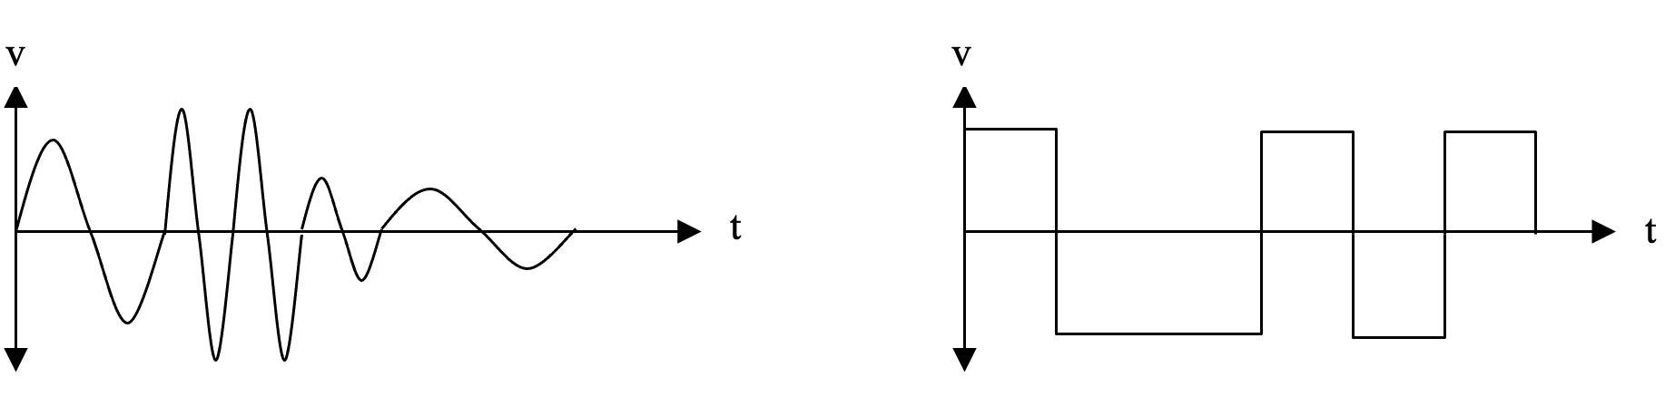
Signals – Con’t
BLM3051
Data Communication and Computer Network - 2
Periodic
Non-periodic
Dr. Öğr. Üyesi Furkan ÇAKMAK

Slide 6
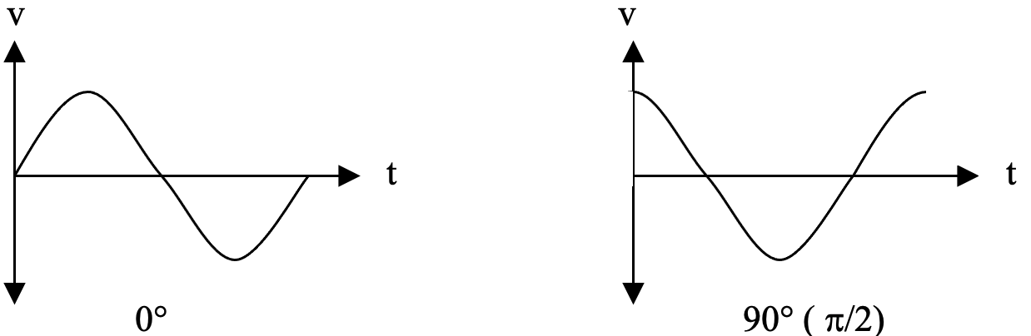
Analog Signals
BLM3051
Data Communication and Computer Network - 2
Simple Analog Signals
v – Amplitude
Volt - V
Amper - A
Watt-W
f – Frequency
Cycle
Hertz - Hz
φ - Phase
Degree - °
Radian - π
Frequency | Time
Hz | sec (second)
KHz | msec (milli second)
MHz | μsec (micro second)
GHz | nsec (nano second)
THz | psec (pico second)
Complex Analogue Signals
Dr. Öğr. Üyesi Furkan ÇAKMAK

Slide 7
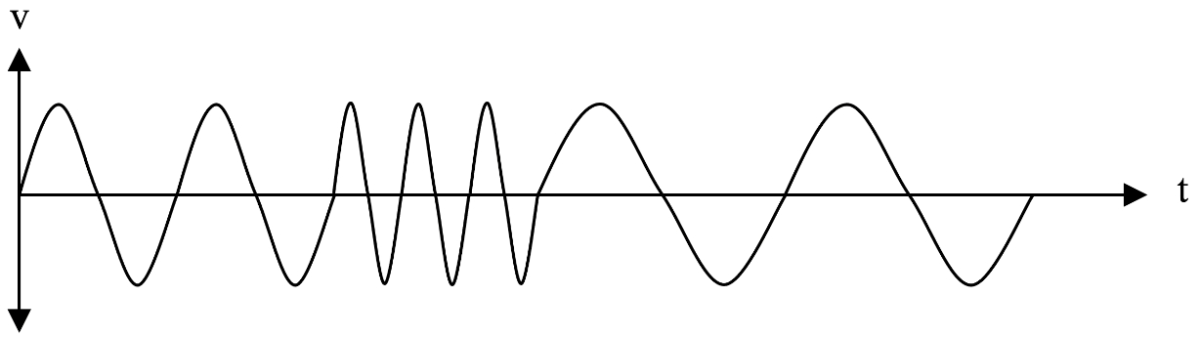
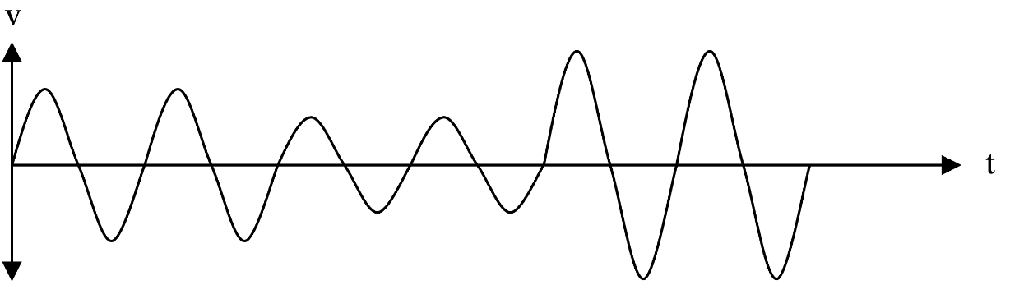
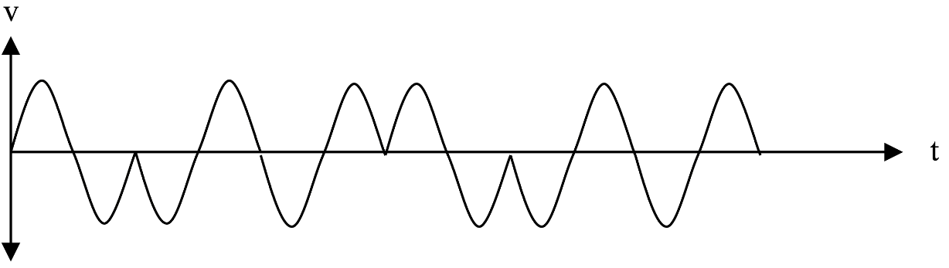
Analog Signals – Con’t
BLM3051
Data Communication and Computer Network - 2
Frequency Change
Amplitude Change
Phase Change
Dr. Öğr. Üyesi Furkan ÇAKMAK

Slide 8
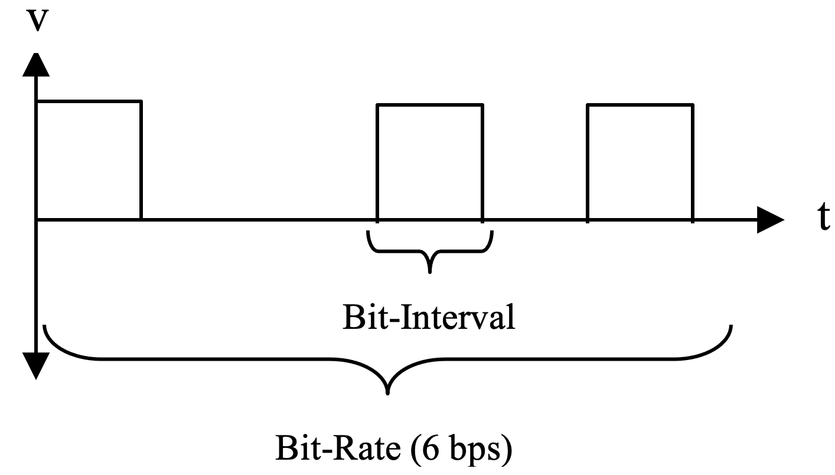
Digital Signals
BLM3051
Data Communication and Computer Network - 2
Non-periodic
Bit-rate
The number of bits transferred in one second
Bit-interval
The time it takes to transmit one bit (in seconds)
Dr. Öğr. Üyesi Furkan ÇAKMAK

Slide 9
Elements that Negatively Affect Communication
BLM3051
Data Communication and Computer Network - 2
Distortion
Attenuation
dB
Solution: Amplifying
Analog?
Noise
Even Idle mode
Thermal noise
Motion of atomic fragments
Impulse noise
Random electromagnetic signal
Cross talk
Delay
Propagation: Velocity of a sinusoidal signal in a transmission line
Dr. Öğr. Üyesi Furkan ÇAKMAK

Slide 10
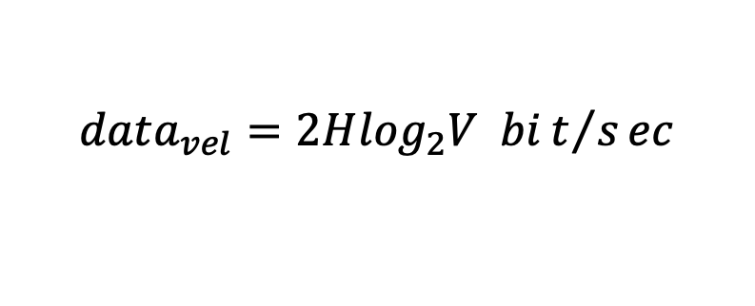
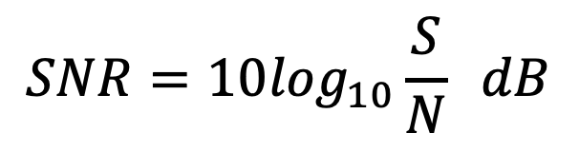
Data Carrying Capacity
BLM3051
Data Communication and Computer Network - 2
Nyquist Theorem
The amount of data that can be sent per unit time
H: Band width
V: Number of discrete voltages
Not consider the noise
Noise (dB)
Signal strength (sent): S
Strength of the current noise: N
$$data_{vel}=2H\log_{2}V bit/sec$$
$$SNR=10\log_{10}\frac{S}{N} dB$$
Dr. Öğr. Üyesi Furkan ÇAKMAK

Slide 11
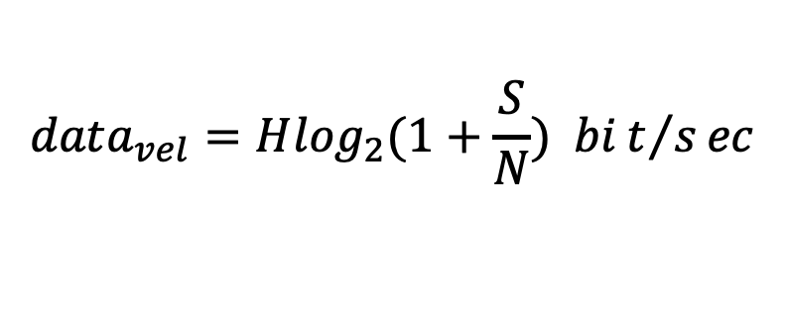
Data Carrying Capacity – Con’t
BLM3051
Data Communication and Computer Network - 2
$$data_{vel}=H\log_{2}(1+\frac{S}{N}) bit/sec$$
Shannon-Hartley
Data velocity with noise
First, the highest data rate to be achieved is found according to the Shannon-Hartley formula.
Then, according to the Nyquist formula, how many discrete voltage levels can be used in this bandwidth is determined.
Dr. Öğr. Üyesi Furkan ÇAKMAK

Slide 12

Example
BLM3051
Data Communication and Computer Network - 2
Since it is known that the SNR value on a transmission channel between 3KHz-4KHz is 24dB, what is the maximum rate that can be obtained and the number of discrete levels that can be used for transmission?
Dr. Öğr. Üyesi Furkan ÇAKMAK

Slide 13
Coding of Signals
BLM3051
Data Communication and Computer Network - 2
Digital – Digital
Computer – Printer
Analog – Digital
Microphone – Computer
Digital – Analog
Computer – Communication Lines
Analog – Analog
Radio – Radio Signal Lines
Dr. Öğr. Üyesi Furkan ÇAKMAK

Slide 14
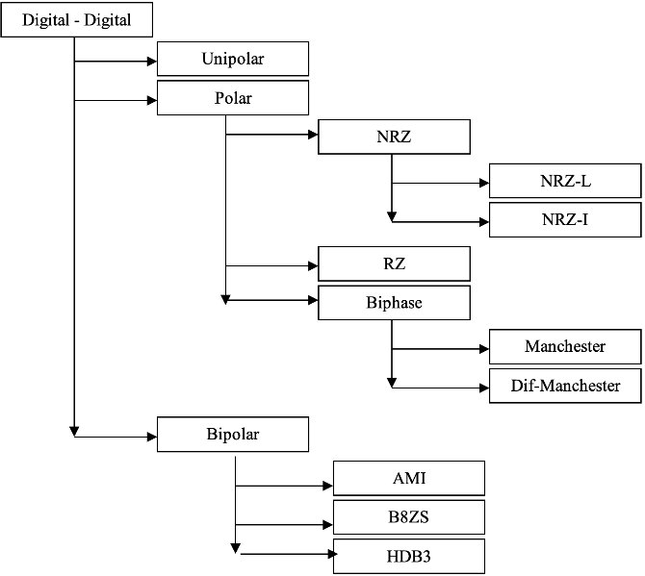
Digital – Digital Coding
BLM3051
Data Communication and Computer Network - 2
Dr. Öğr. Üyesi Furkan ÇAKMAK

Slide 15
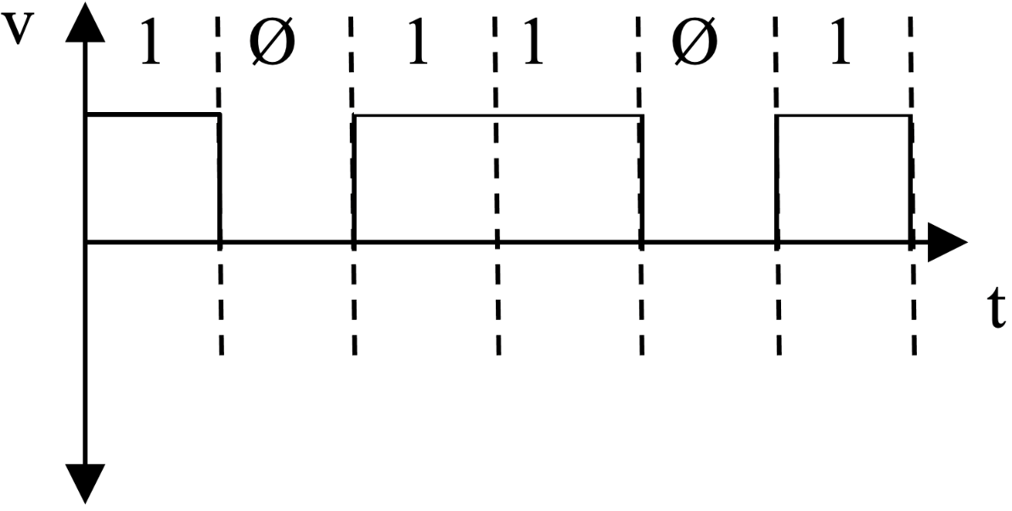
Digital2Digital – Unipolar Coding
BLM3051
Data Communication and Computer Network - 2
2 main problems;
DC Component
Synchronization
Dr. Öğr. Üyesi Furkan ÇAKMAK

Slide 16
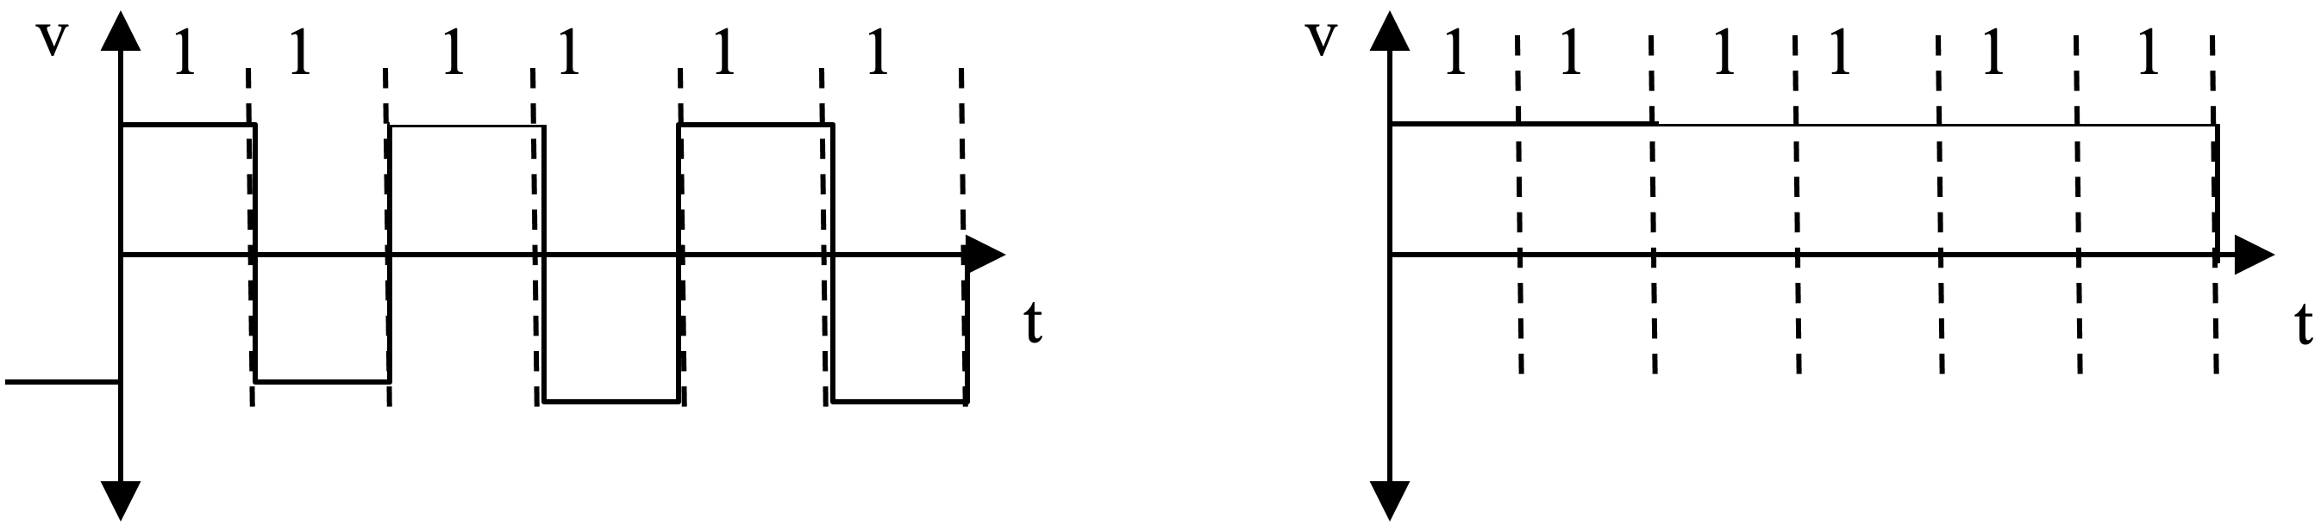
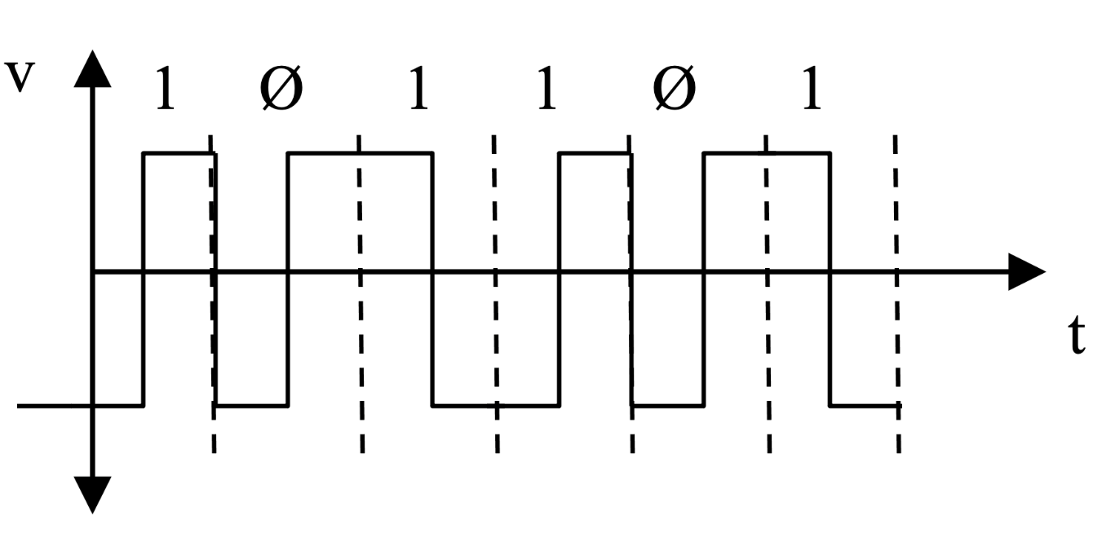
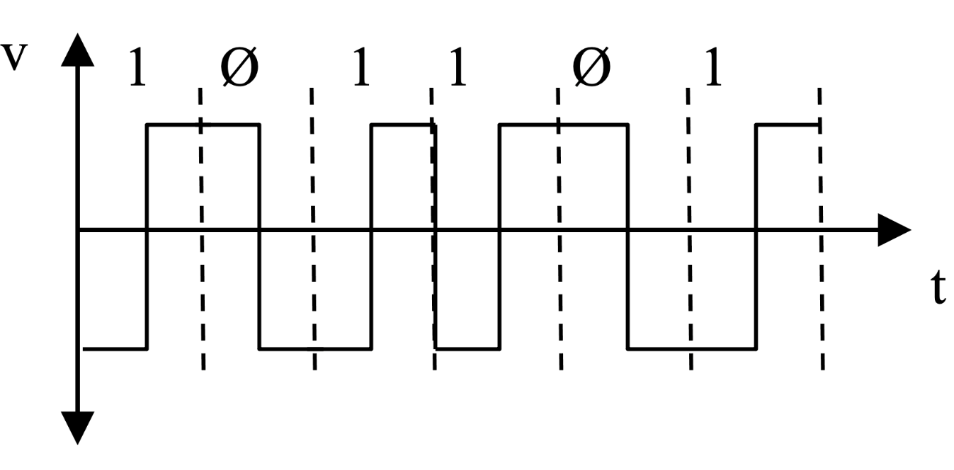
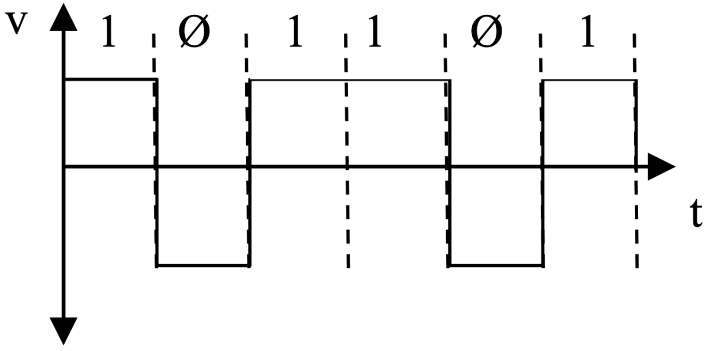
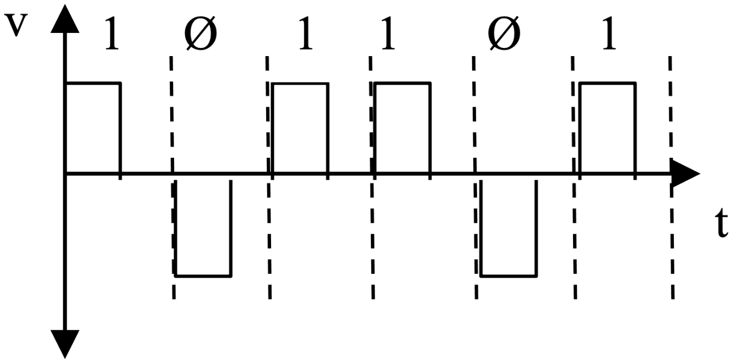
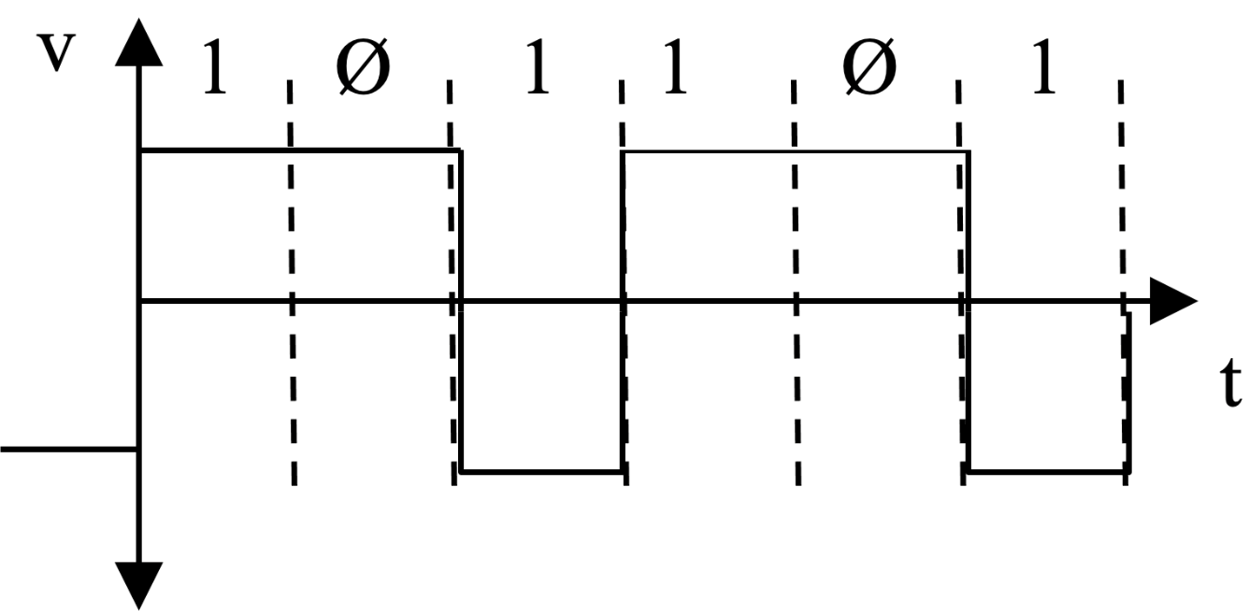
Digital2Digital – Polar Coding
BLM3051
Data Communication and Computer Network - 2
3 main types
Non Return to Zero (NRZ)
Non Return to Zero-Level (NRZ-L)
Non Return to Zero-Inverted (NRZ-I)
Return to Zero (RZ)
Biphase
Best Digital2Digital Technique
Manchester
Differential Manchester
Dr. Öğr. Üyesi Furkan ÇAKMAK

Slide 17
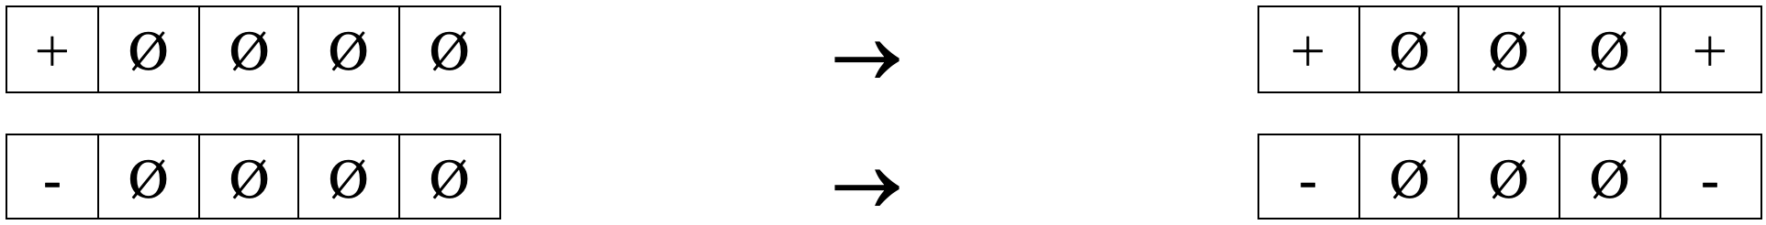
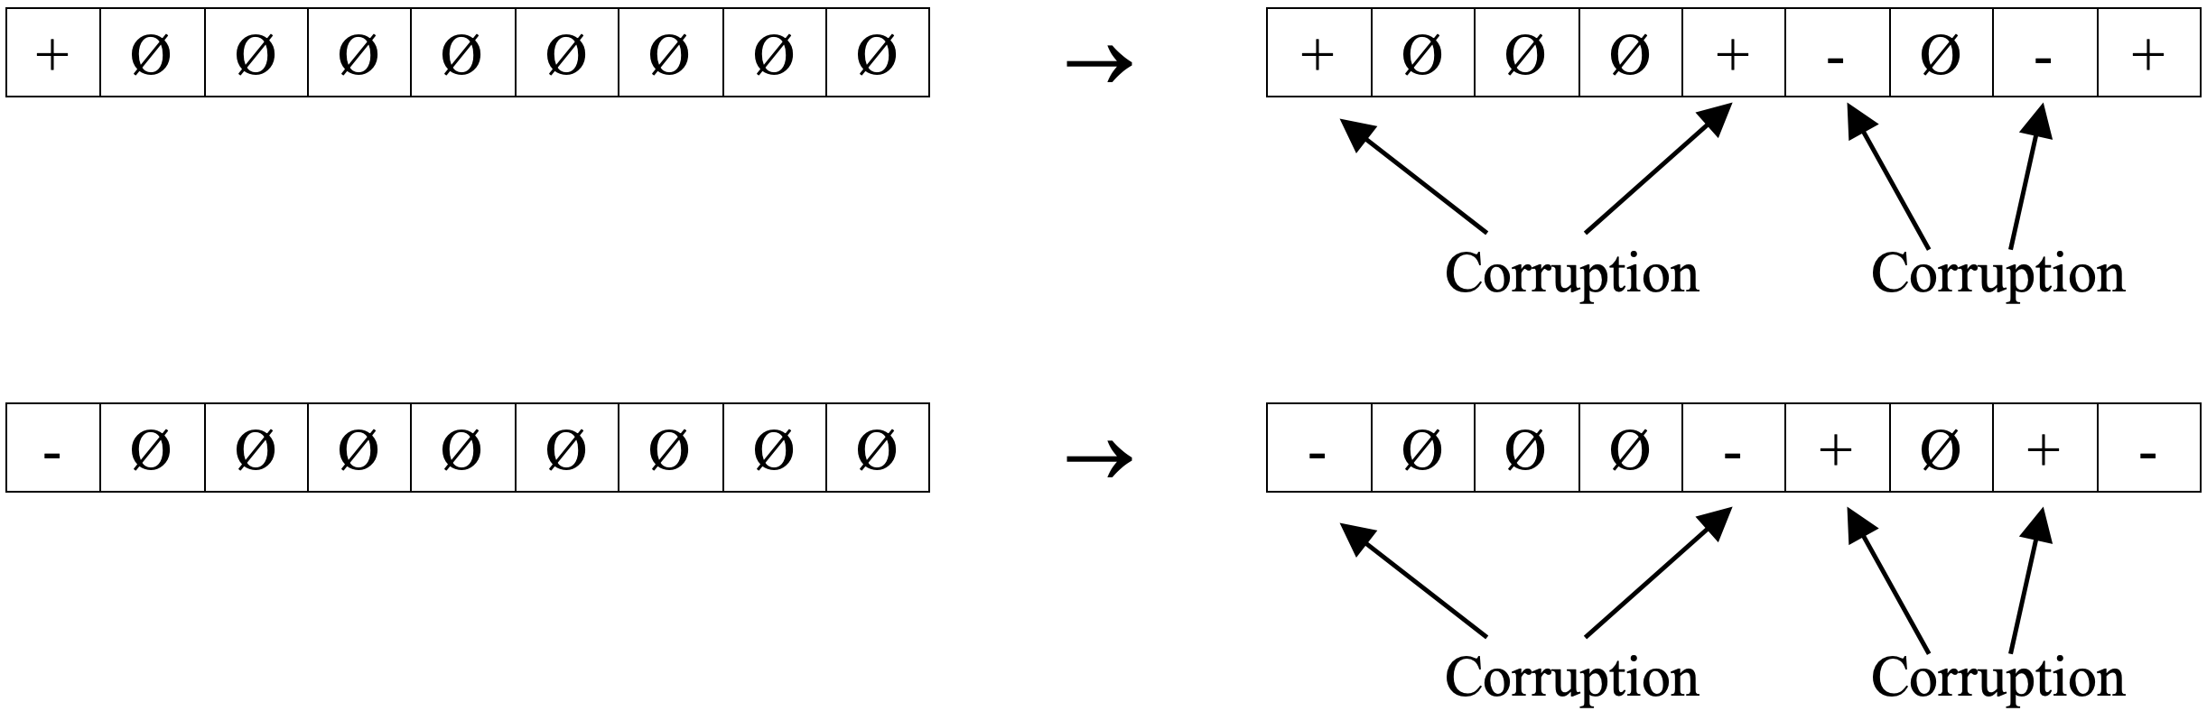
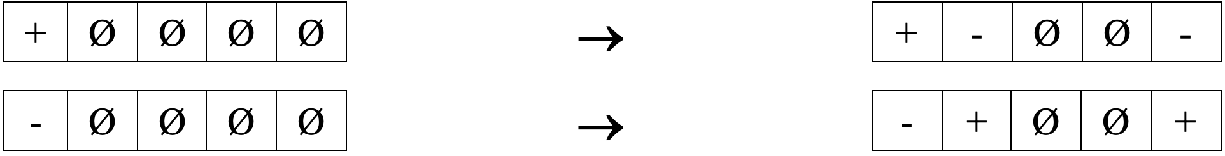
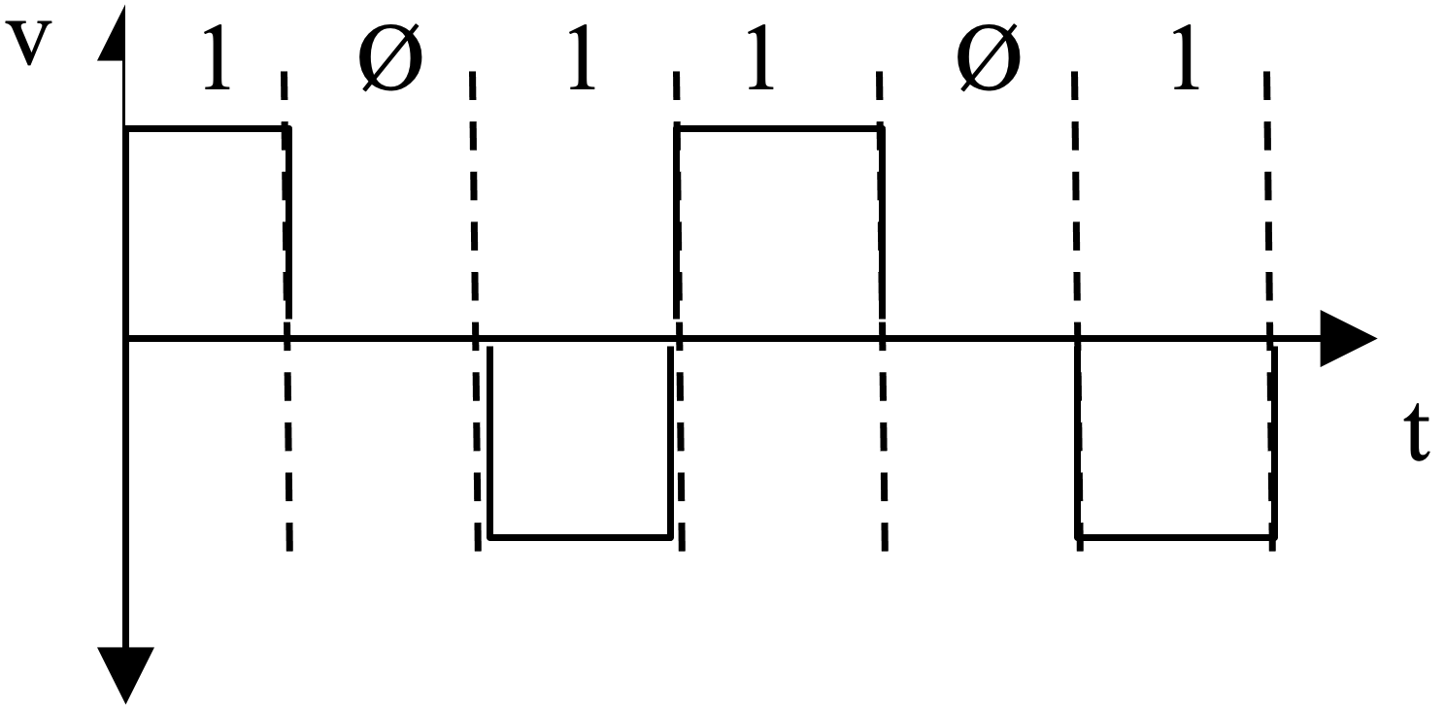
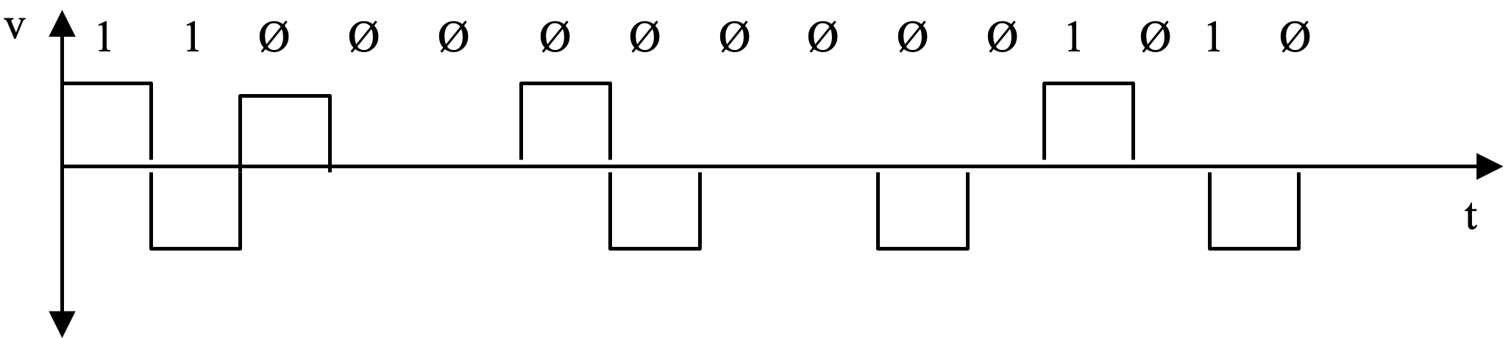
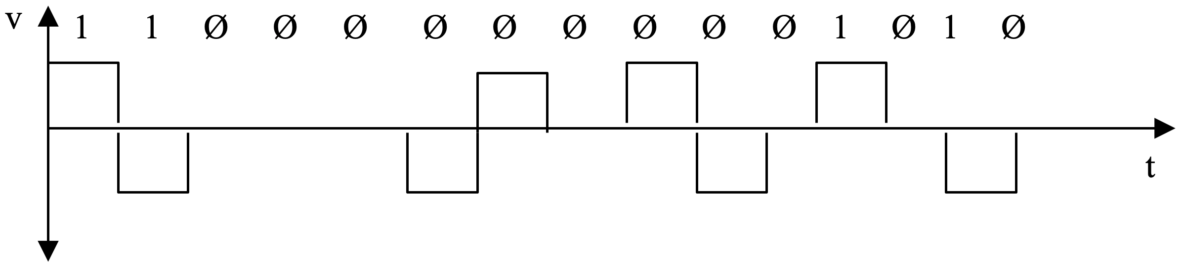
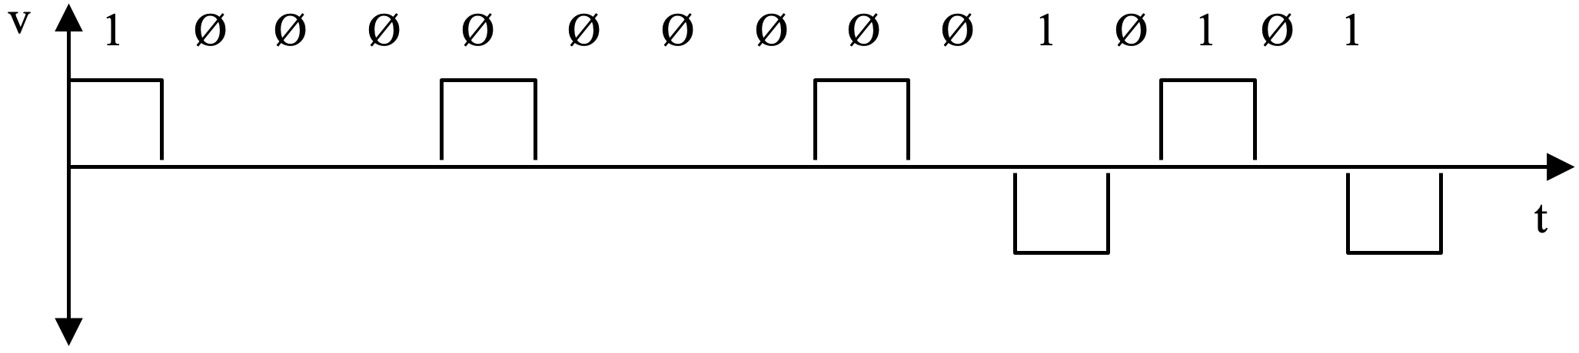

Digital2Digital – Bipolar Coding
If the number of 1s transferred after the last conversion is odd
BLM3051
Data Communication and Computer Network - 2
If the number of 1s transferred after the last conversion is even
3 voltage levels
(+, - and 0) like RZ
0V $⟹$ 0
+, - $⟹$ 1
AMI (Alternate Mark Inversion)
B8ZS (Bipolar 8 Zero Synchronizing)
HDB3 (High Density Bipolar 3)
Data before the HDB3 Coding is even
Data before the HDB3 Coding is odd
Dr. Öğr. Üyesi Furkan ÇAKMAK

Slide 18
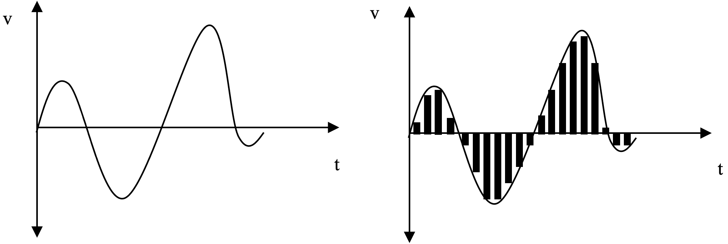
Analog – Digital Coding
BLM3051
Data Communication and Computer Network - 2
PAM (Pulse Amplitude Modulation)
Dr. Öğr. Üyesi Furkan ÇAKMAK

Slide 19
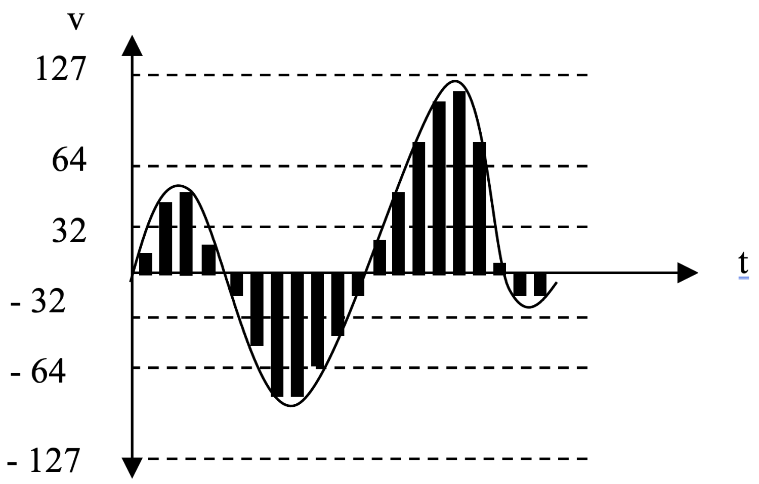
Analog – Digital Coding – Con’t
BLM3051
Data Communication and Computer Network - 3
PCM (Pulse Code Modulation)
Dr. Öğr. Üyesi Furkan ÇAKMAK

Slide 20
Analog – Digital Coding - Nyquist Theorem
BLM3051
Data Communication and Computer Network - 2
Sampling at least twice the highest frequency component is required
Example:
If bandwith is 1000-4000Hz, sampling fre. must be 8000
Dr. Öğr. Üyesi Furkan ÇAKMAK

Slide 21
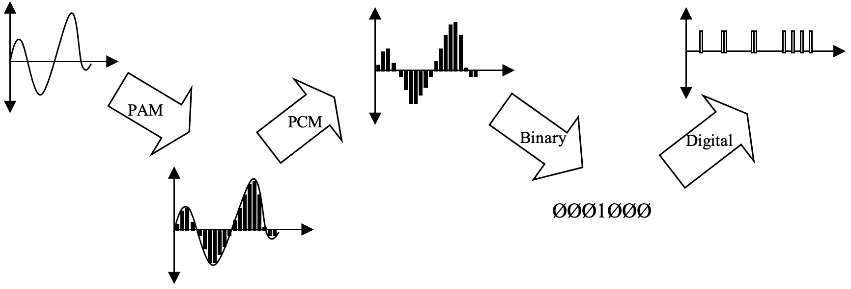
Transmission of the Analog Signal over the Digital Network
BLM3051
Data Communication and Computer Network - 2
Dr. Öğr. Üyesi Furkan ÇAKMAK

Slide 22
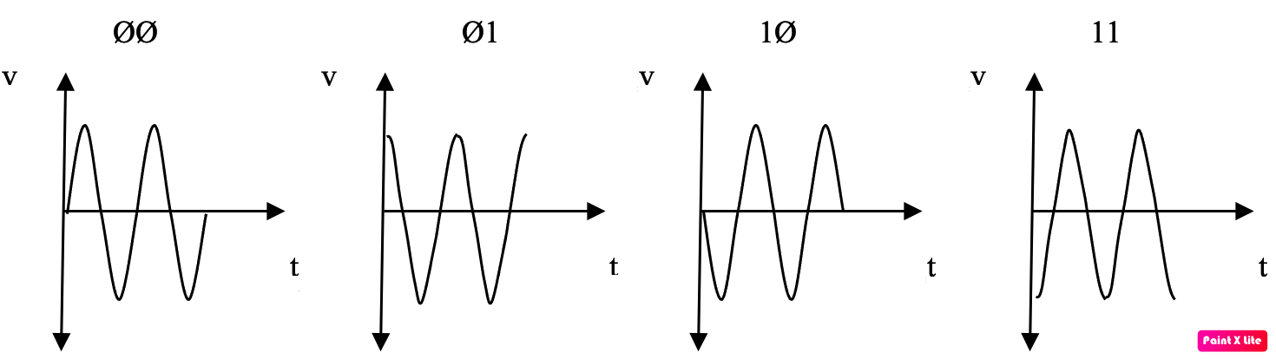
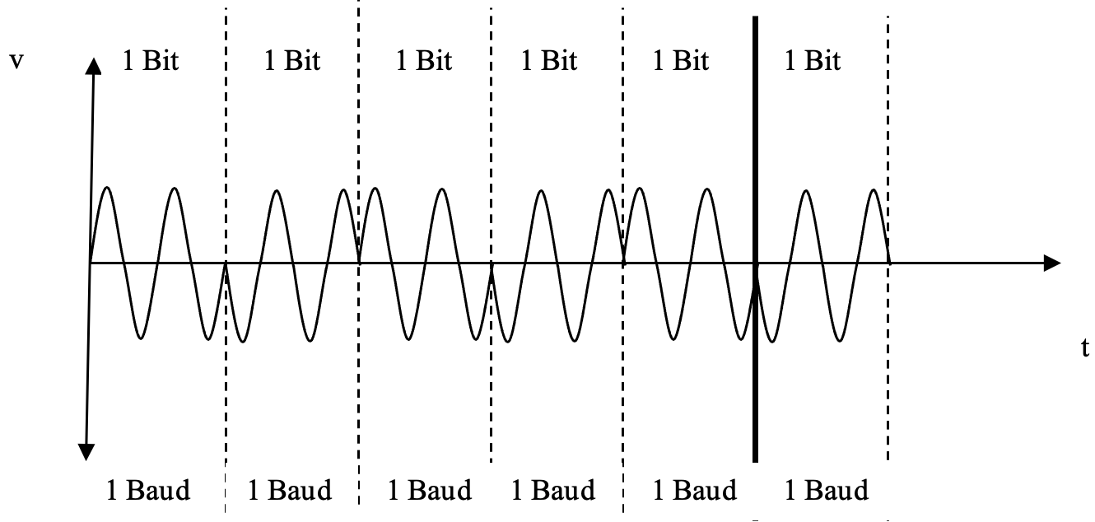
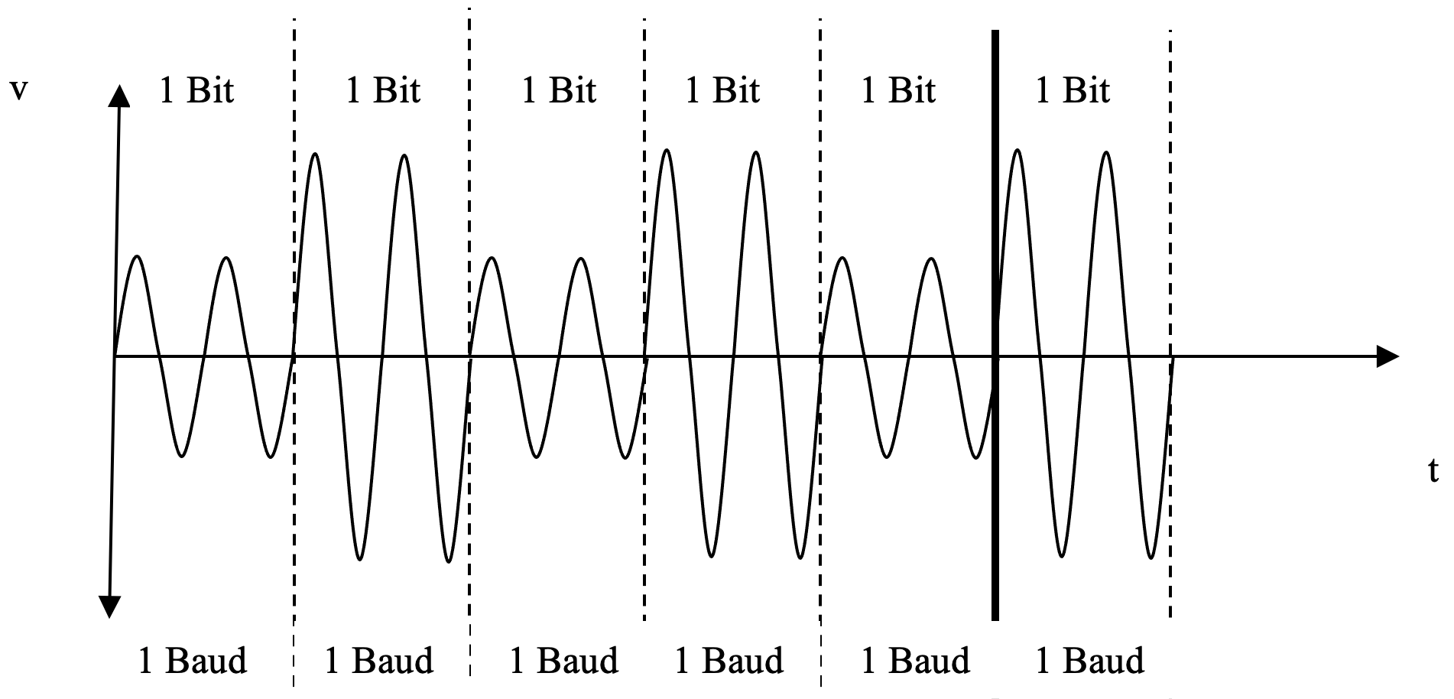
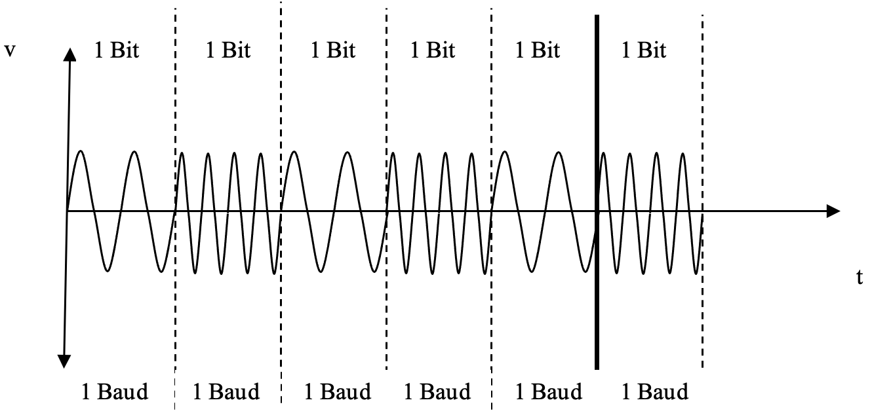

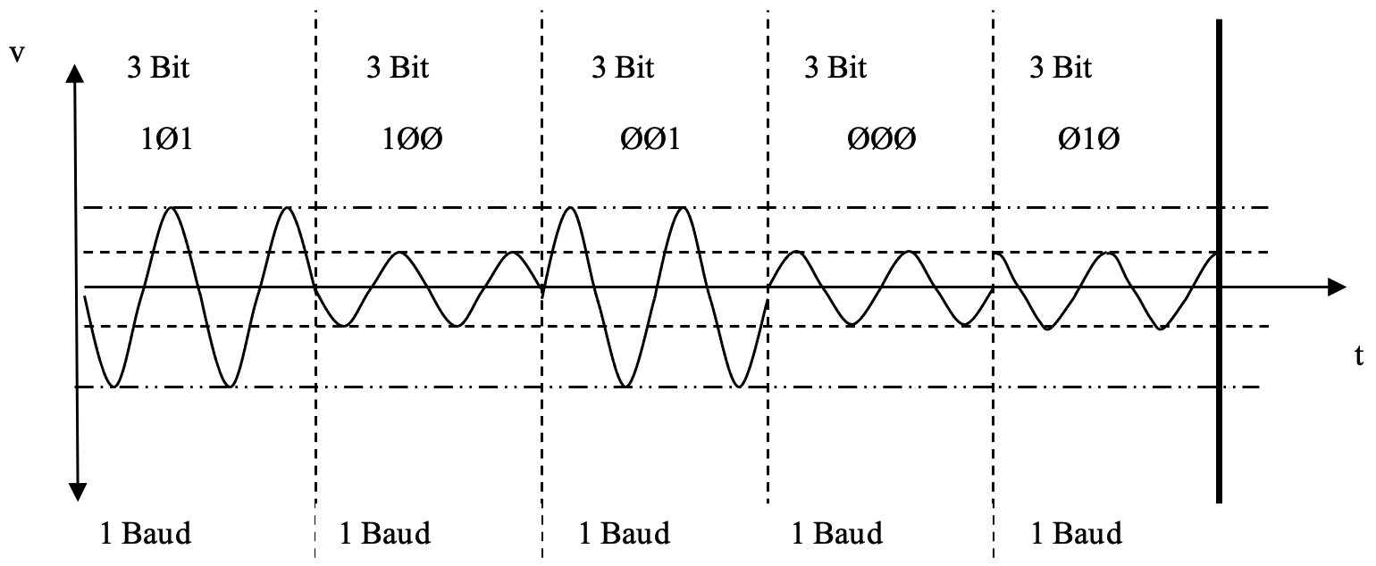
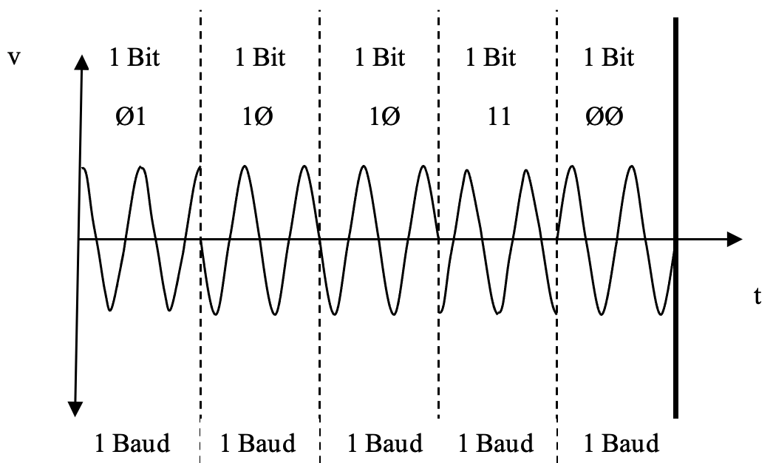

Digital – Analog Coding
BLM3051
Data Communication and Computer Network - 2
ASK (Amplitude Shift Keying)
FSK (Frequency Shift Keying)
PSK (Phase Shift Keying)
It is not affected by voltage additions caused by external environment effects such as ASK, and bandwidth related problems such as FSK.
QAM (Quadrature Amplitude Modulation)
PSK $⨁$ ASK
4 phase + 2 amp.
Dr. Öğr. Üyesi Furkan ÇAKMAK

Slide 23
Analog – Digital Coding - Concepts
BLM3051
Data Communication and Computer Network - 2
Coding Technique | Unit | Baud Speed | Bit Speed | Bits / Baud
ASK, FSK,2PSK | Bit | N | N | 1
4PSK, 4QAM | Dibit | N | 2N | 2
8PSK, 8QAM | Tribit | N | 3N | 3
16QAM | Quadbit | N | 4N | 4
32QAM | Pentabit | N | 5N | 5
64QAM | Hexabit | N | 6N | 6
128QAM | Septabit | N | 7N | 7
256QAM | Octabit | N | 8N | 8
Carrier Signal
Bit and Baud Speed
Bit Speed ≥ Baud Speed
Dr. Öğr. Üyesi Furkan ÇAKMAK

Slide 24
Analog – Analog Coding
BLM3051
Data Communication and Computer Network - 2
AM (Amplitude Modulation)
FM (Frequency Modulation)
PM (Phase Modulation)
Dr. Öğr. Üyesi Furkan ÇAKMAK

Slide 25
Digital Data Transmission Techniques
BLM3051
Data Communication and Computer Network - 2
Medium specs;
Connector type to provide mechanical connection in the transmission medium
Number of wires
Signal type
Purpose
Frequency, amplitude and phase
Parallel Transmission
Serial Transmission
Dr. Öğr. Üyesi Furkan ÇAKMAK

Slide 26

Parallel Transmission
BLM3051
Data Communication and Computer Network - 2
Ø
1
1
Ø
N Wired Connection
Dr. Öğr. Üyesi Furkan ÇAKMAK

Slide 27
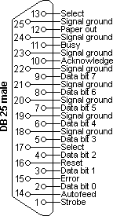
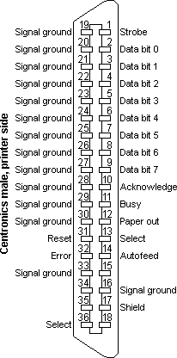
Parallel Transmission – Con’t
BLM3051
Data Communication and Computer Network - 2
Standard Parallel Interface
155 kByte/sec
ECP/EPP (Enhanced Parallel Port/Enhanced Capability Port)
3 MByte/sec
Maximum Cable Length: 7.5m
Dr. Öğr. Üyesi Furkan ÇAKMAK

Slide 28
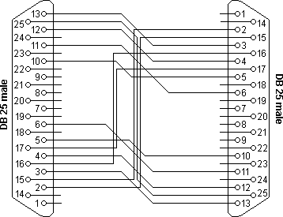
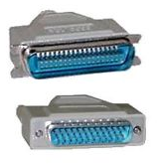
Parallel Transmission – Con’t
BLM3051
Data Communication and Computer Network - 2
Laplink
Interlink
Dr. Öğr. Üyesi Furkan ÇAKMAK

Slide 29
Serial Transmission
BLM3051
Data Communication and Computer Network - 2
Ø
1
Ø
1
1
Ø
1
Dr. Öğr. Üyesi Furkan ÇAKMAK

Slide 30
Serial Transmission – Con’t
BLM3051
Data Communication and Computer Network - 2
RS–232-C
9 wires
RX
TX
GND
6 x Flow Control Wire
155 kbits/sec
15 meters
NRZ-L
(-15~-5)V_{DC}→1
(+5~+15)V_{DC}→Ø
RS–422: 300 meters
Asynchronous transmission in WAN
2 wires
Synchronous transmission in WAN
4 wires
Dr. Öğr. Üyesi Furkan ÇAKMAK

Slide 31
Asynchronous Serial Transmission
BLM3051
Data Communication and Computer Network - 2
Simple, Cheap
The data arrival rhythm between the sides is not the same.
It is not possible to tell when the incoming transmission started and when it ends
Receiver and transmitter must agree on how long each bit will remain on the line.
Start bit: 0, positive voltage
8-N-1
1 + 8 + 1 -> LSB
N: not parity bit
7-E-1
1 + 7 + 1 (Even)
Stop bit: 2-bits long
Dr. Öğr. Üyesi Furkan ÇAKMAK

Slide 32
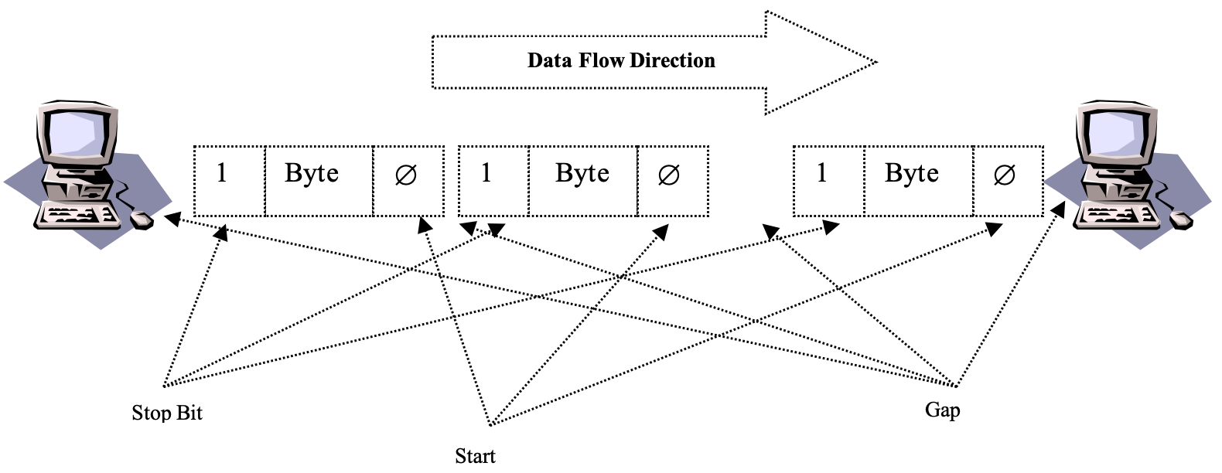
Asynchronous Serial Transmission – Con’t
BLM3051
Data Communication and Computer Network - 2
Since the communication between the sender and receiver is not made simultaneously, there are gaps of variable duration between the bytes sent.
Dr. Öğr. Üyesi Furkan ÇAKMAK

Slide 33
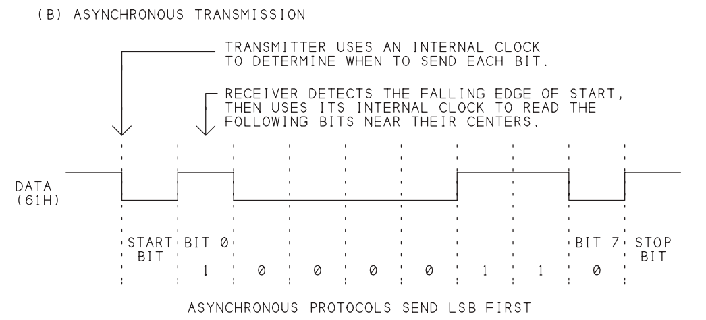
Asynchronous Serial Transmission – Con’t
BLM3051
Data Communication and Computer Network - 2
Time skew
If the processing speed difference between the two sides is 5%
8th -> 45%
Dial-up
Carrier Signal
Dr. Öğr. Üyesi Furkan ÇAKMAK

Slide 34
Synchronous Serial Transmission
BLM3051
Data Communication and Computer Network - 2
Much more big data transfer compare to Async within one transmission (>1000 byte)
If there is no data transmission
A special bit sequence is sent in the line.
In order for the information to be transferred properly, operations must be carried out depending on a common timing mark.
Like an assembly line.
Clock line: A different line
Clock pulse
Short distance transmissions
Dr. Öğr. Üyesi Furkan ÇAKMAK

Slide 35
Synchronous Serial Transmission – Con’t
BLM3051
Data Communication and Computer Network - 2
Logical Level Synchronization
Preamble Bit Array
Postamble Bit Array
Max 100 bits for control data.
HDLC (High Level Data Link Control)
48 bits for control purposes.
Example
If we want to transfer 1000 characters in HDLC mode, how much bits send?
1 character → 8 bit
1000 characters → 1 block
Control data → 48-bit
1 block → 8000 bit
8000 + 48 → 8048 bits
Load of control data per bloc → 48 / 8048 ≈ 0,6%
Dr. Öğr. Üyesi Furkan ÇAKMAK

Slide 36
Asynchronous ST vs Synchronous ST
BLM3051
Data Communication and Computer Network - 2
Synchronous | Asynchronous
Much more efficient usage Better error control High transmission speed | Simple Cheap Additional effort required for timing Limited speed Limited error control mechanism (parity) 20% loss due to start / end bits
Dr. Öğr. Üyesi Furkan ÇAKMAK

Slide 37

Thank you for your listening.
BLM3051
Data Communication and Computer Network - 2
Dr. Öğr. Üyesi Furkan ÇAKMAK

